Slide 1
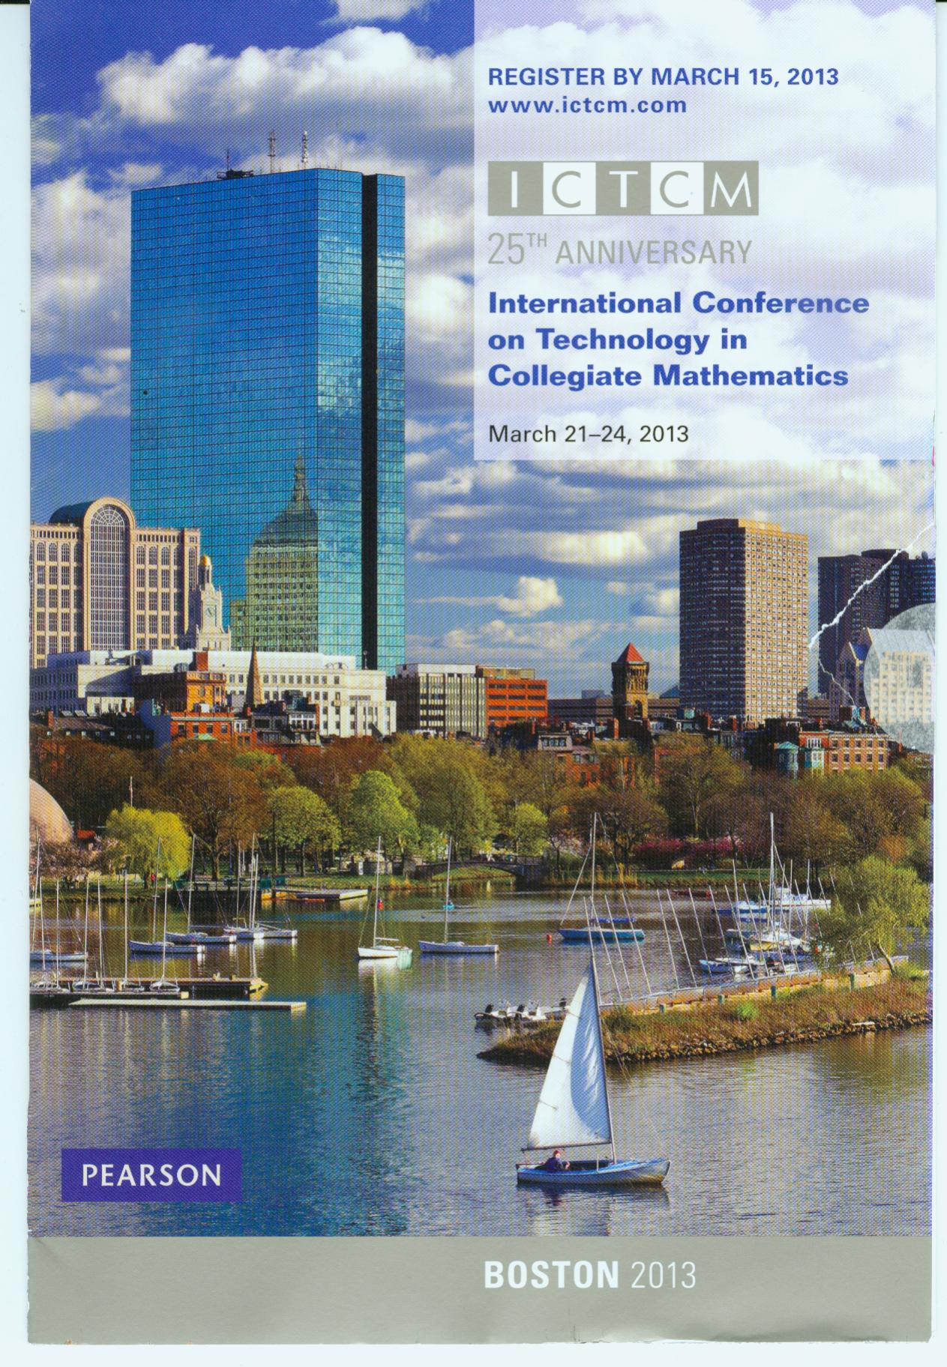
The Charge – Improve Success Rates in Intermediate Algebra Using Technology
Shawna Haider
www.shawnahaider.com

Slide 2
The presidents of all Utah colleges and universities gave the charge to redesign Intermediate Algebra utilizing technology

Slide 3
wanted to impose a state-wide model
“compromise” was for each school to design and run a pilot and then get back together to assess and determine if there was a good “state-wide” model

Slide 4
classroom lecture (2 days per week)
computer lab (2 days per week alternating with classroom days)
Students watch section videos or read the book, make a section outline and take a readiness quiz before attending classroom days
conceptual material, theorems, definitions etc. and applied examples in the classroom
Lab activities to work in groups and discover and reinforce material
individualized help from the instructor, and fellow classmates in the lab

Slide 5
module review that then personalizes an extended review based on objectives not mastered in the module review
chance to remediate with a personalized assignment with tutorial help based on the objectives not yet mastered
opportunity to test again (one week window in which to do this)
module review that then personalizes an extended review based on objectives not mastered in the module review
chance to remediate with a personalized assignment with tutorial help based on the objectives not yet mastered
opportunity to test again (one week window in which to do this)

Slide 6
60% of the students in this pilot have taken Math 1010 in the past
students help each other in the lab
students try until they get the problem correct

Slide 7
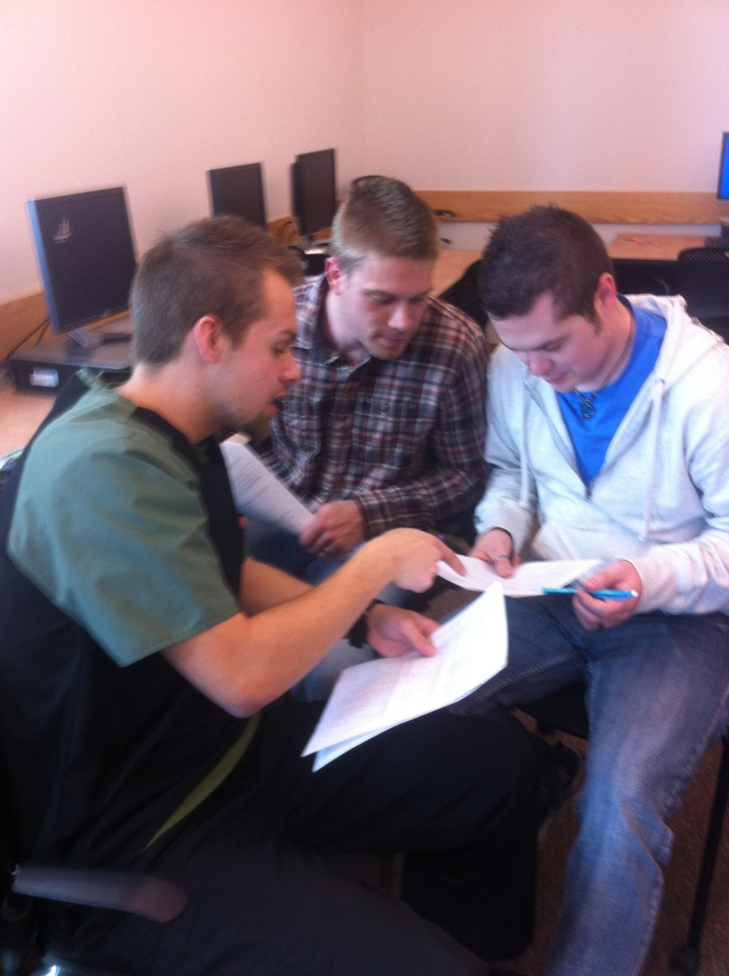
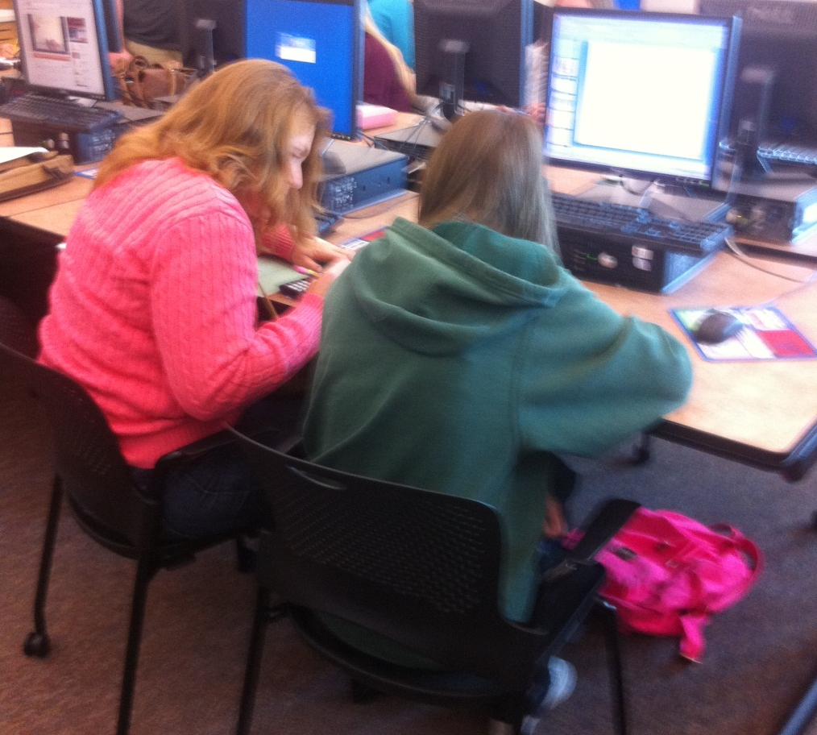

Slide 8
Intro to MyMathLab
Linear Functions Lab
Absolute Value and Inequalities Lab
Linear Modeling Lab
Factoring Lab
Long Division Lab
Fractions Lab
Linear Programming Lab
Radical Lab
Quadratic Functions Lab
Complex Numbers Lab

Slide 9
Hated TNG in the beginning but now I enjoy and like the format! I wish all classes were like this! I am usually not very good at math but I feel like I learned everything so well!
I think this program was the best way to learn the math. The help was so valuable. I would love for every math course to be like this. I was so lucky to have chosen this course. I didn't know it's format initially.

Slide 10
I loved having both lab and lecture it made the class seem more worth taking because I had help in class and I didn't feel on my own at home. I really liked the balance.

Slide 11
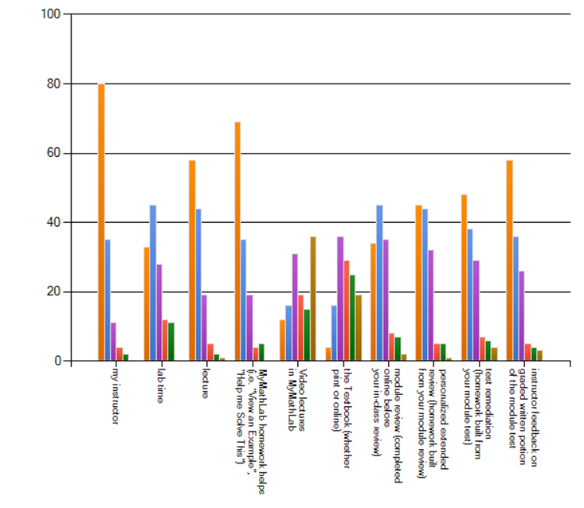
What things helped you learn the material in this class?

Slide 12
They help me work together with my classmates - we discuss the questions and they help me understand. | 83%
The Lab Activities help me to better understand the concepts we are studying. | 100%
They help me to successfully complete the group projects. | 92%
The Lab Activities make me think hard about topics in our course. | 92%
I refer back to my Lab Activities to help when working on homework or projects. | 67%

Slide 13
Please rate the following weekly formats for a Math 1010 Intermediate Algebra course
 | This is the format I would most prefer | I would like to take a class in this format | Neutral | I would rather not take a class in this format | I would never take a class in this format
4 days lecture no lab days | 21.8% (24) | 10.0% (11) | 20.0% (22) | 35.5% (39) | 12.7% (14)
3 days lecture 1 day lab | 14.7% (16) | 27.5% (30) | 25.7% (28) | 26.6% (29) | 5.5% (6)
2 days lecture 2 days lab | 53.8% (64) | 16.0% (19) | 16.8% (20) | 8.4% (10) | 5.0% (6)
1 day lecture 3 days lab | 8.7% (9) | 17.3% (18) | 15.4% (15) | 37.5% (39) | 21.2% (22)
No lecture days 4 days lab | 4.9% (5) | 6.9% (7) | 11.8% (12) | 25.5% (26) | 51.0% (52)

Slide 14
Term | Course Type | Pass | C-DWF | W | Total | Pass Rate with W | Pass Rate without W
Spring 2012 | TNG 9 sections | 115 | 71 | 30 | 216 | 53.24% | 61.83%
Spring 2012 | non-TNG sample 7 sections | 91 | 115 | 20 | 226 | 40.27% | 44.17%
Fall 2011 | TNG 6 sections | 87 | 63 | 9 | 159 | 54.72% | 58.00%

