Slide 1
A Model for Change:
Building Partnerships to Develop Math Accessibility Guidelines

Slide 2
Presenters
Candida Darling, Disability Resource Center Director
Shawna Haider, Professor of Mathematics
Paula Michniewicz, Instructional Designer

Slide 3
Presentation Outline
Theoretical framework for motivating change
Math faculty perspective
Instructional Designer perspective
Our group’s outcomes --- and what’s next

Slide 4
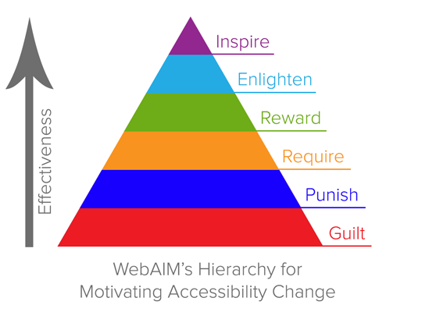
WebAIM’s Hierarchy

Slide 5
Universal Access Committee
Executive cabinet established a standing committee in 2012
30 members (designated by VP of Student Affairs)
Key administrators
Faculty
Staff
Student leadership
Emphasizes cross-college collaboration and shared responsibility
Ongoing budget--$50,000

Slide 6
Universal Access Sub-Committees
ADA policy
Accessible instruction
Accessible technology
Physical access
Professional development
Universal access study
SLCC transition plan

Slide 7
Math Accessibility Working Group
Met with Associate Dean of Mathematics
Senior Math faculty
Instructional Designers
Disability Resource Center
No set agenda at first--just presented the problem and asked the team to help solve it.

Slide 8
Making It Work
Focus on department-specific challenges
Goal oriented
Faculty-driven
Flexible timeline
Allow for learning and exploration
Report and share data
Meet regularly to keep momentum

Slide 9
Making It Awesome
Faculty group
Student perspectives
Learning designers
Time

Slide 10
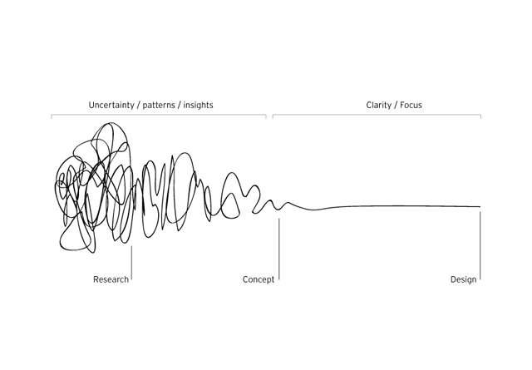
The Squiggle

Slide 11
Technology and Testing
Sent people to CSUN conference and OER Accessibility
Participated in virtual AHEAD conferences
Tested with our LMS (Canvas)
Tested with students and DRC
Universal Access specialist and EIT specialist

Slide 12
Framework of Accessibility Guidelines
Math Department
Textbook selection/creation guidelines
Document creation guidelines
Disability Resource Center
Support students with assistive technology
Future --- Students will be able to do their own homework

Slide 13
Textbooks and OER
Textbook Checklist
Open Educational Resources (OER)
SLCC work on OER book for Trigonometry

Slide 14
Document Creation Guidelines
Create a source document that can then be used for various accessibility needs
Word with headings
MathType equations
Alt-tag images
Accompanying file of SVG graphics

Slide 15
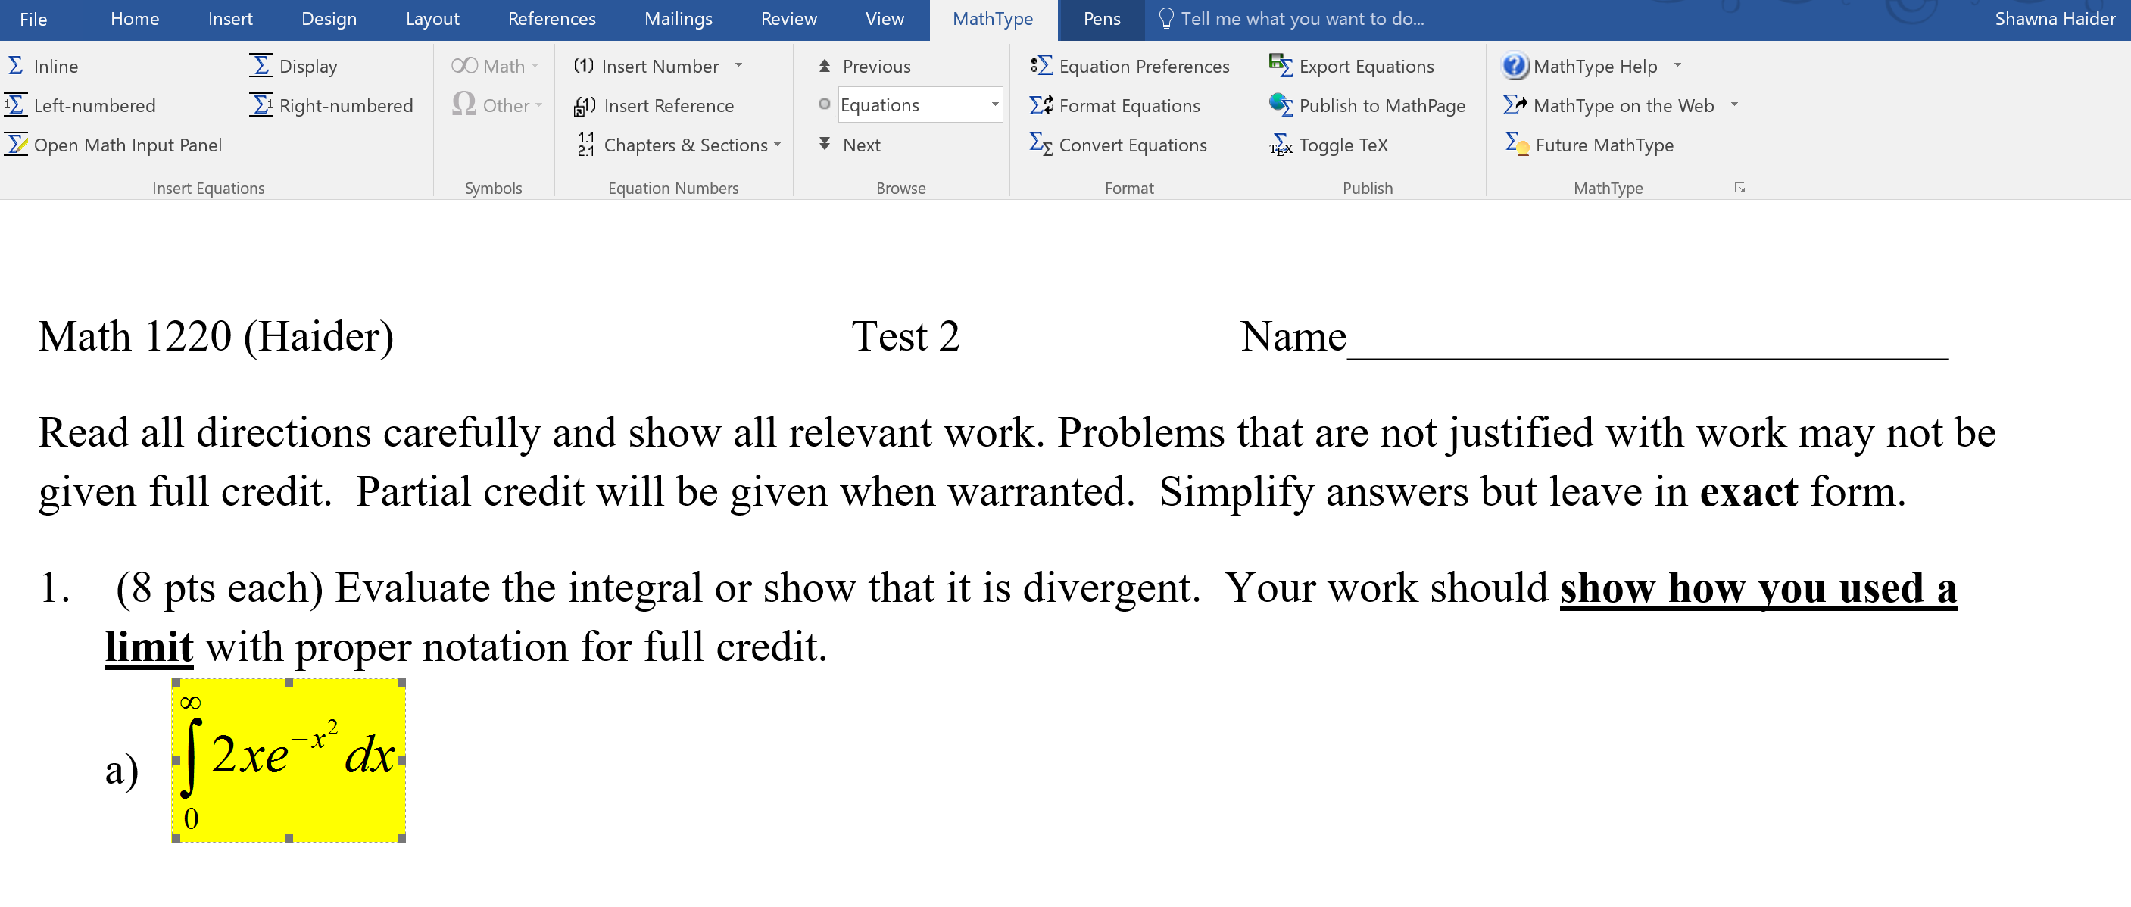
Publish to MathPage

Slide 16
Publish to MathPage

Slide 17
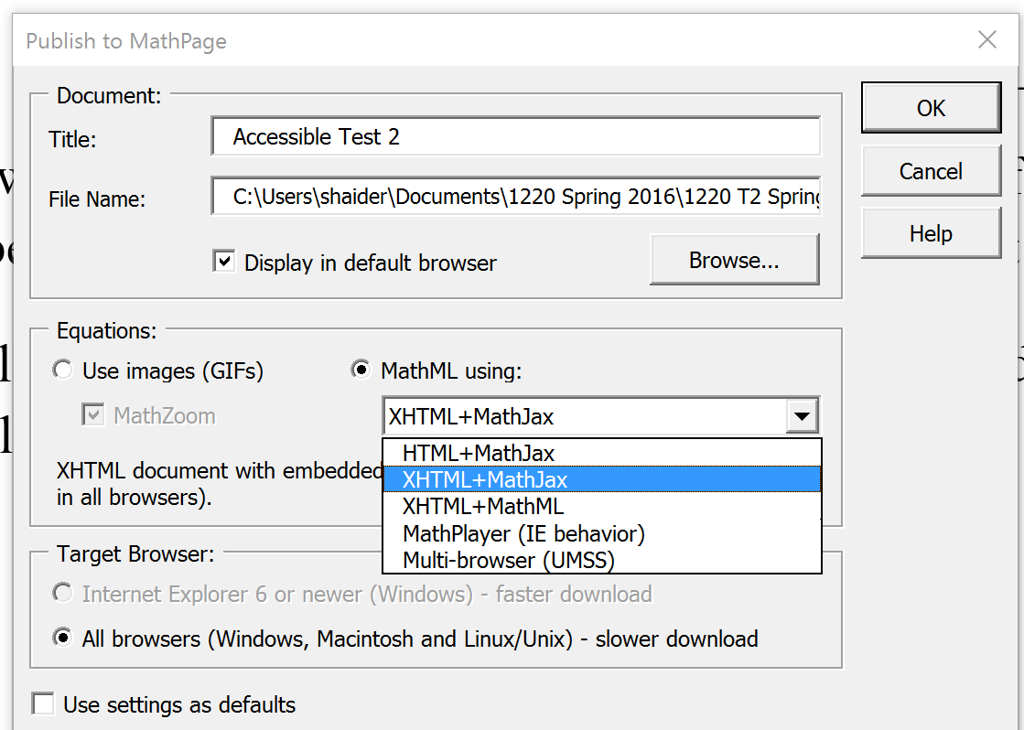
Publish to MathPage

Slide 18
XHTML + MathJax

Slide 19
XHTML + MathJax

Slide 20
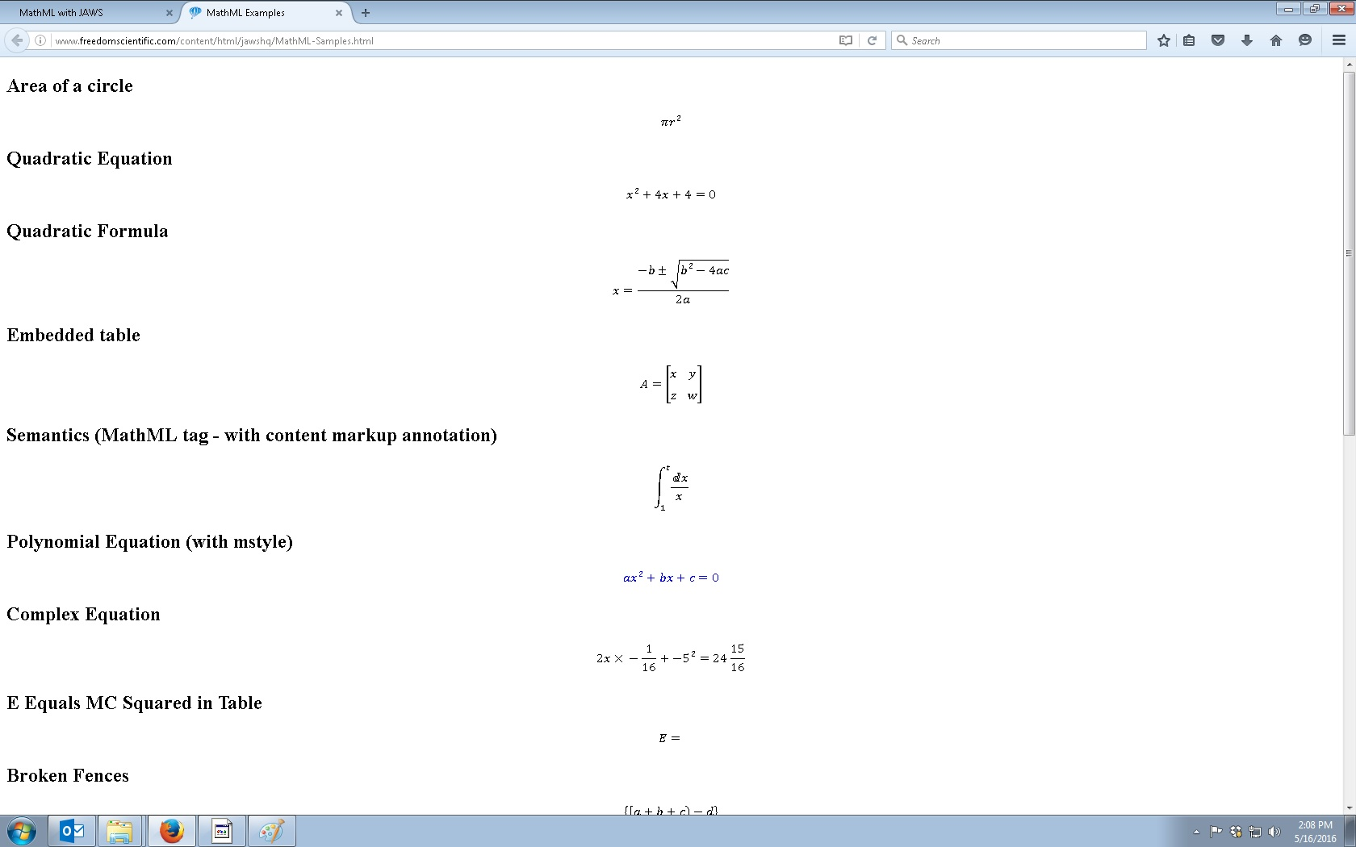
XHTML + MathJax

Slide 21
XHTML + MathJax

Slide 22
Culture Change
eLearning
Math Department
DRC (models for other departments i.e. English department)

Slide 23
WebAIM’s Hierarchy

Slide 24
Contact Information
Candida Darling, Disability Resource Center Director
Candida.Darling@slcc.edu
Shawna Haider, Professor of Mathematics
Shawna.Haider@slcc.edu
Paula Michniewicz, Instructional Designer
Paula.Michniewicz@slcc.edu

